Slide 1
FREEBIES FOR NEWBIES
A place to find free event and items
Team Members:
Aditya Krishna Raavi
Manoj Kumar Gude
Harish Chowdary Bala
Saibabu Devarapalli
Jaichand Mulakalapalli
Client & Mentor:
Dr. Chandra Mouli Kotteti

Slide 2
Team Members
JAICHAND MULAKALAPALLI
(TEAM LEADER) BACKEND
MANOJ KUMAR GUDE
FRONTEND
ADITHYA KRISHNA RAAVI
FRONTEND
Saibabu devarapalli
Fullstack
HARISH CHOWDARY BALA
DATABASE
DR. CHANDRA MOULI KOTTETI
Mentor & Client

Slide 3
Table of Contents
Scroll View In Android
Action Bar (Navigation Bar)
Recycler View (in XML)
Back4App Database
Intents
RecylerViews
Lessons Learned
Summary
Date Picker and Time Picker

Slide 4
Scroll View
In Android Scroll View is a View group that is used to make vertically scrollable views.
It contains single direct child as Child so we can declare many view in it.
They are many types of scroll views like Horizontal scroll view, Vertical scroll view, Dynamic scroll views .
In Linear Layout only the scroll view will work because it fallows parent child hierarchy where as in relative layout it contains right node and left node(child).
The Scroll view contains many attributes to get the view as per project requirements.
Scroll View is easy to use, but it's not recommended for long, scrollable lists. In that scenario we use Recyclable views.
Reference: https://www.geeksforgeeks.org/scrollview-in-android/

Slide 5
Date Picker
Date Picker is common dialogue used in every app.
Date Picker contains controls selecting each date month and year thing.
In Android we use Dialog Fragment for getting the Date Picker.
Dialog Fragment manages the dialog lifecycle to display Date picker in the Different configurations.
You can use AUTOFILL method for date and time pickers .In some cases
The date picker is invisible then we can enter the date manually by using the AUTOFILL_TYPE_DATE ().

Slide 6
Time Picker
Date Picker and Time Picker are both dialogues which prompt on the screen when an action is pressed .
For these Time Picker Dialogue also we use Dialog Fragment and return a TimePickerDialog from the fragments onCreateDialog() method.
Implement the TimePickerDialog.OnTimeSetListener interface to receive a callback when the user sets the time.
You can Display the TimePickerDialogue by creating the instance of the DialogFragment Show()
Auto Fill Value Object that represents the date ion milliseconds. To create the forDate() method to generate Autofill Value Object.

Slide 7
Action Bar (Navigation Bar)
An Action Bar is a piece of dedicated real estate that appears at the top of each screen (usually).
It provides a place to display:
Navigational controls (to drill down into hierarchical data) .
Controls to support switching from one view to another.
Your app's icon, a good branding opportunity.
A way of indicating your user’s location within the app.

Slide 8
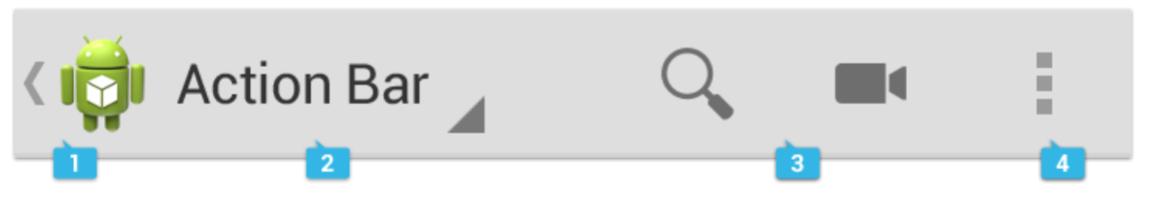
Action Bar(Navigation Bar)
App icon (including an "up caret") (indicated by the 1) .
Place for drop-down menu or tabs to switch among screens
If your app doesn't require navigational controls, could also display the app name.
Action buttons (text, icons, or a combination thereof).
Action overflow, for infrequently used actions.
Fig 1: Sample Navigation Bar

Slide 9
Recycler View(in XML)
RecyclerView makes it easy to efficiently display large sets of data.
As the name implies, RecyclerView recycles those individual elements.
When an item scrolls off the screen, RecyclerView doesn't destroy its view. Instead, RecyclerView reuses the view for new items that have scrolled onscreen.
This reuse vastly improves performance, improving your app's responsiveness and reducing power consumption.

Slide 10
Recycler View(in XML)
To implement a basic RecyclerView three sub-parts are needed .They are:
Card Layout: The card layout is an XML layout which will be treated as an item for the list created by the RecyclerView.
ViewHolder: The ViewHolder is a java class that stores the reference to the card layout views that have to be dynamically modified during the execution of the program by a list of data obtained either by online databases or added in some other way.
Data Class: The Data class is a custom java class that acts as a structure for holding the information for every item of the RecyclerView.

Slide 11
Database: Back4App
Low-code backend to build modern apps
Store and query relational data on the cloud. Make it accessible over GraphQL and REST with a scalable, open-source backend.
Real-Time Database
Build real-time apps by storing and querying relational data between your users with strong user-based security.
APIs & SDKs
Get a smooth, easy-to-use experience when you build using our simple APIs (GraphQL/REST) and SDKs.

Slide 12
Back4App: Parse Object Create Query
// Configure Query ParseObject soccerPlayers = new ParseObject("SoccerPlayers"); // Store an object soccerPlayers.put("playerName", "A. Wed"); soccerPlayers.put("yearOfBirth", 1997); soccerPlayers.put("emailContact", "a.wed@email.io"); soccerPlayers.addAllUnique("attributes", Arrays.asList("fast", "good conditioning")); // Saving object soccerPlayers.saveInBackground(new SaveCallback() { @Override public void done(ParseException e) { if (e == null) { // Success Log.v("Create Object:","Successful"); } else { Log.v("Create Object:","failed due to ParseException "+e.getMessage()); } } });
Fig 2: Create Query

Slide 13
Back4App: Parse Object Read Query
ParseQuery<ParseObject> query = ParseQuery.getQuery("SoccerPlayers"); query.whereEqualTo("objectId", "HMcTr9rD3s"); query.getFirstInBackground(new GetCallback<ParseObject>() { public void done(ParseObject player, ParseException e) { if (e == null) { String playerName = player.getString("playerName"); int yearOfBirth = player.getInt("yearOfBirth"); String emailPlayer = player.getString("emailContact"); Log.v("playerName",playerName); Log.v("yearOfBirth",String.valueOf(yearOfBirth)); Log.v("emailContact",emailPlayer); } else { Log.v("ParseException",e.getMessage()); } } });
Fig 3: Read Query

Slide 14
Back4App: Parse Object Update Query
ParseQuery<ParseObject> query = ParseQuery.getQuery("SoccerPlayers"); // Retrieve the object by id query.getInBackground("HMcTr9rD3s", new GetCallback<ParseObject>() { public void done(ParseObject player, ParseException e) { if (e == null) { // Now let's update it with some new data. In this case, only cheatMode and score // will get sent to the Parse Cloud. playerName hasn't changed. player.put("yearOfBirth", 1998); player.put("emailContact", "a.wed@domain.io"); player.saveInBackground(); }else { // Failed
Log.v("ParseException",e.getMessage()); } } });
Fig 4: Update Query

Slide 15
Back4App: Parse Object Delete Query
ParseQuery<ParseObject> soccerPlayers = ParseQuery.getQuery("SoccerPlayers"); // Query parameters based on the item name soccerPlayers.whereEqualTo("objectId", "HMcTr9rD3s"); soccerPlayers.findInBackground(new FindCallback<ParseObject>() { @Override public void done(final List<ParseObject> player, ParseException e) { if (e == null) { player.get(0).deleteInBackground(new DeleteCallback() { @Override public void done(ParseException e) { if (e == null) { // Success } else { // Failed } } }); } else { // Something is wrong } } });
Fig 5: Delete Query

Slide 16
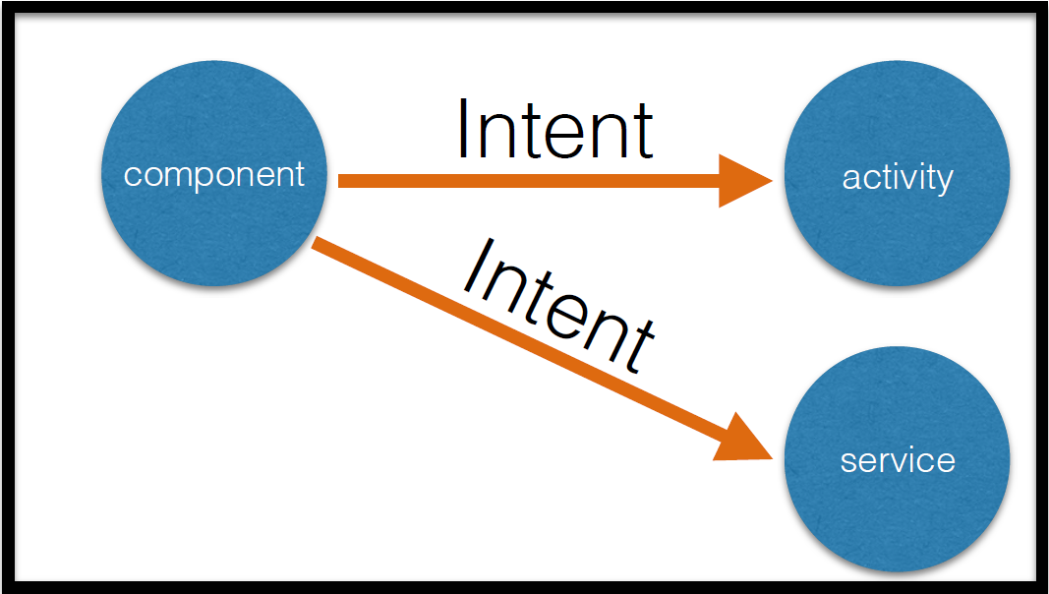
Intents
An intent is a message, sent to an app component (activity, service, broadcast receiver)
Can be used to:
start an activity
start a service
broadcast information to other apps
Fig 6: Intents Usage

Slide 17
Intents: Types
Explicit Intents specify the component to start explicitly, by name. This is usually used to start a component in your own app.
Example:Intent downloadIntent = new Intent(this, DownloadService.class);
downloadIntent.setData(Uri.parse(fileUrl));
startService(downloadIntent);
Implicit Intents do not specify a component by name; rather they specify an action that needs to be performed. Android then delivers that intent to an app capable of performing that action.
Example:Intent sendIntent = newIntent();
sendIntent.setAction(Intent.ACTION_SEND);
sendIntent.putExtra(Intent.EXTRA_TEXT, textMessage);
startActivity(sendIntent);

Slide 18
Intents: Sending Intents
startActivity(Intent intent)
Intent can be either explicit or implicit:
public Intent(Context start Activity, Class classname)
public Intent(String action)
Example: // Create the text message with a string
Intent sendIntent = new Intent();
sendIntent.setAction(Intent.ACTION_SEND);
sendIntent.putExtra(Intent.EXTRA_TEXT, textMessage);
sendIntent.setType(HTTP.PLAIN_TEXT_TYPE); // "text/plain" MIME type

Slide 19
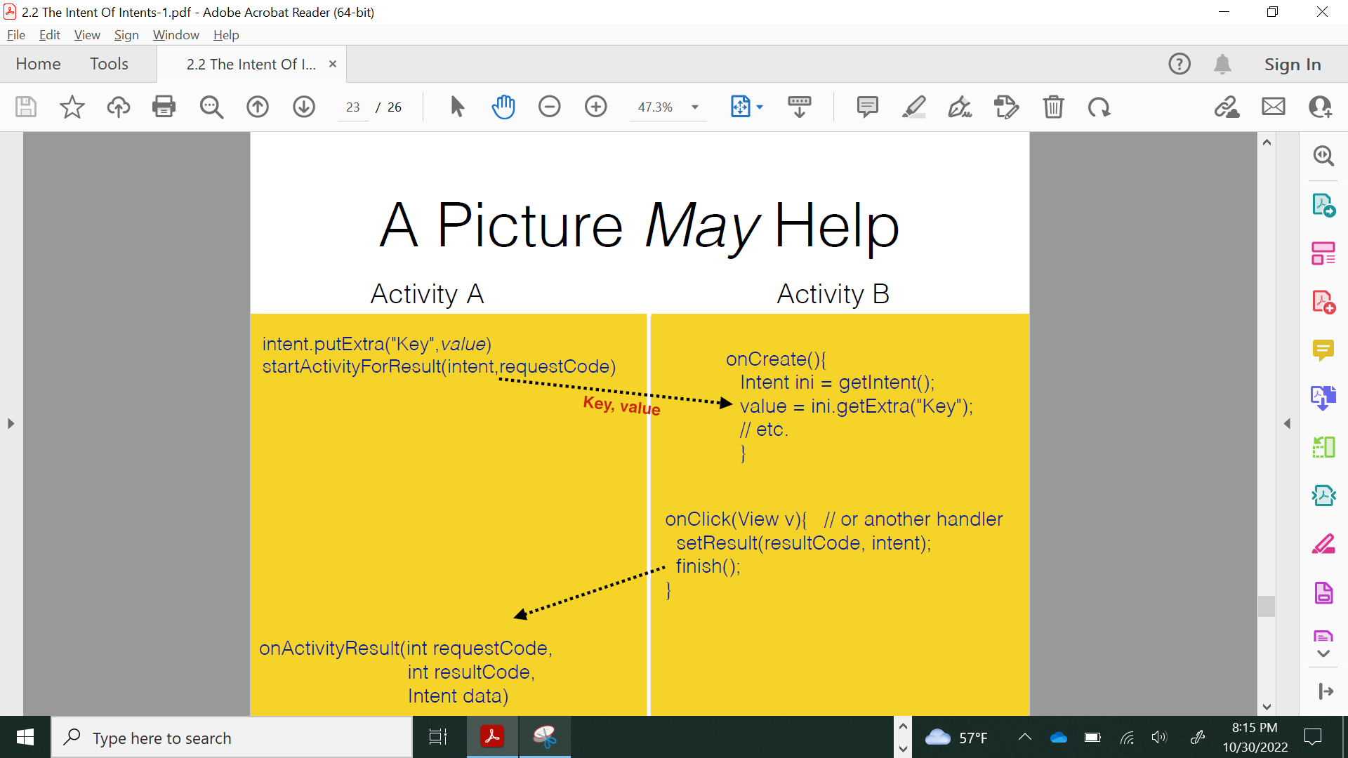
Intents: A Simple Illustration
Fig 7: Simple example of how Intents are used

Slide 20
RecyclerViews
A single column table, aka a vertically scrolling, horizontally filled list of Views. This is a more flexible/advanced version of a ListView.
RecyclerView makes it easy to efficiently display large sets of data.
You supply the data and define how each item looks, and the RecyclerView library dynamically creates the elements when they're needed.
When an item scrolls off the screen, RecyclerView doesn't destroy its view. Instead, RecyclerView reuses the view for new items that have scrolled onscreen.
This reuse vastly improves performance, improving your app's responsiveness and reducing power consumption.

Slide 21
RecyclerView: Adapter
Subclass the recycler adapter to work with a data source and bind data to a ViewHolder.
Need to override:
onCreateViewHolder(ViewGroup parent, int viewType) - Called when the RecyclerView needs a new ViewHolder.
onBindViewHolder(ViewHolder, int) - Update the view holder to reflect the data at the given position in the data set.
getItemCount() - Return the number of items in the data source.

Slide 22
RecyclerView: Steps to Implement
Add a RecyclerView to the activity layout.
Create a layout to use for the subviews.
Define a concrete adapter class inheriting from RecyclerView.Adapter.
Define a concrete ViewHolder class inside my adapter inheriting from Recycler.ViewHolder.
Create a data model.

Slide 23
RecyclerView: Steps to Implement
Override the abstract methods onCreateViewHolder, onBindViewHolder, and getItemCount in the concrete adapter.
Create an instance of the adapter with a reference to the data using the subview layout.
Attach the adapter to the RecyclerView.
Create and instance of a LayoutManager and attach to the RecyclerView.

Slide 24
Lessons Learned
There is a process-scope limit of 1MB of data being passed between components. Please keep in mind that this does not mean that you can pass 1MB of data safely, as there may be multiple Intents being processed at a time.
If an event causes the model to change, the Adapter needs to notify the RecyclerView so that it can change the view inside any affected ViewHolders.
Example: notifyDataSetChanged() - Redo it all.
notifyItemChanged(int position) - Contents of a particular value has changed.
and few more other methods.

Slide 25
Summary
In this presentation, we covered the topics that we have learned after the midterm1, mainly RecyclerView, Adapters, ScrollViews, Intents, Parse Queries etc.,
We have given few examples for each topic to have a clear understandings.
We discussed few limitations on the intents and other components used.

Slide 26
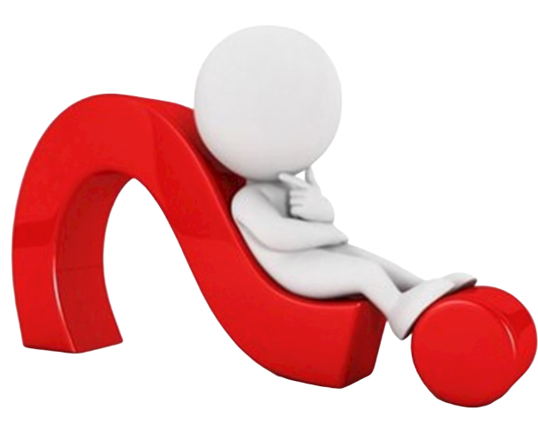
Thank You Everyone..!
Any Queries..?

Slide 27
Team Members
JAICHAND MULAKALAPALLI
(TEAM LEADER) BACKEND
MANOJ KUMAR GUDE
FRONTEND
ADITHYA KRISHNA RAAVI
FRONTEND
Saibabu devarapalli
Fullstack
HARISH CHOWDARY BALA
DATABASE
DR. CHANDRA MOULI KOTTETI
Mentor & Client

Slide 28
FREEBIES FOR NEWBIES
A place to find free event and items
Team Members:
Aditya Krishna Raavi
Manoj Kumar Gude
Harish Chowdary Bala
Saibabu Devarapalli
Jaichand Mulakalapalli
Client & Mentor:
Dr. Chandra Mouli Kotteti

